Slide 1
School Counselor classroom and group counseling programs can have a powerful impact of student performance”
2025
Hiding In Plain Sight: School Counselors-
A Sometimes Under-utilized Resource
Greg Brigman, Ph.D.
gbrigman@fau.edu

Slide 2
Promoting Your Classroom and
Group Counseling Programs
Even though school counseling has broad and deep research on impacting student academic success and social/emotional health
it remains an underutilized resource in many of our schools.

Slide 3
Hiding In Plain Sight: School Counselors-
A Sometimes
Under-utilized
Resource
Promoting your Classroom and small group programs that have an impact
Law of Parsimony
Large impact when you use evidence-based programs
Latest research reviews supporting impact you can have
Concrete steps to collaborate with Administration and increase your access to students

Slide 4
WIIFM:
Promoting Your Classroom and
Group Counseling Programs
Lemberger (2022)
  Found that, on average, school counselors who identified their school as ASCA-aligned spent more time doing appropriate duties as defined by the ASCA National Model.
  Conversely, school counselors that identified their school as not ASCA-aligned spent more time on average doing non-appropriate activities as defined by ASCA.

Slide 5
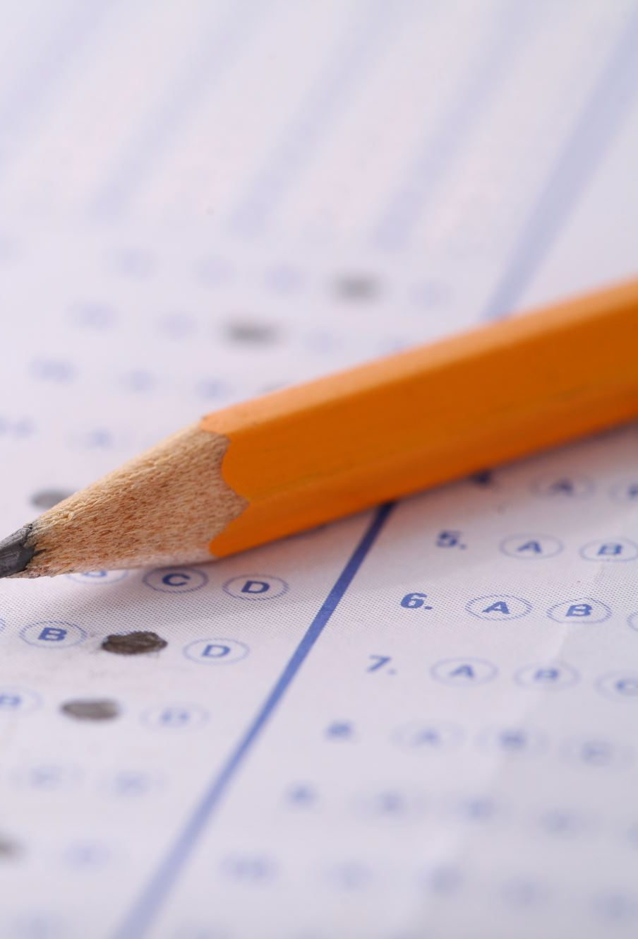
Villares et al, (2021)
Conducted a similar review of how COVID-19 effected school counselor ability to support student mental health and found results similar to Lemberger (2022).
This study analyzed school counselors’ (N = 589) delivery of program services identified as four approaches to school counseling:
reactive, universal, consultative/collaborative, and comprehensive

Slide 6
Villares et al, (2021)
School counselors in the reactive profile
spent most of their time engaged in non-counselor-duties and reported the highest levels of burnout.
Conversely, counselors belonging to the comprehensive profile
devoted the most time to delivering consultation, coordination, counseling, and curriculum services
and limited engagement in non-counseling-related duties
and reported lower levels of burnout

Slide 7
Principal of Parsimony
Defined as “The scientific principle that things are usually connected or behave in the simplest or most economical way” (Oxford Dictionary, 2021)
Helps you to reach all students with your core curriculum
Helps you provide counseling services that might not be available to students otherwise
Classroom Core Curriculum
Small Group Counseling
Individual Counseling
Referral
Notes:
How to get the most out of your school counseling program!
Focus on College/Career Readiness, Non-cognitive Factors and SEL using:
Systematic classroom-based programs that are evidence-based
Systematic group counseling programs that are evidence-based

Slide 8
How do you make the case for school counselors to be fully utilized
Outcome research that shows:
School Counselor led classroom and small group interventions impact student achievement, college/career readiness and social/emotional health and wellbeing

Slide 9
3 Meta-Analyzes of
School Counselor Research
Tell a compelling story
Whiston, 2011;
Villares et al, 2023
Villares et al, 2012;

Slide 10
Whiston et al., (2011)
Effect sizes for:
Cognitive measures - GPA = .15. (medium)
Achievement Test = .16 (medium)
Behavioral Measures- Discipline referrals = .83 (large)
Student problem solving =.96 (large)
Affective Measures – Self esteem = .19 (small)
Anxiety = .40. (small)
Depression = .37 (small)
117 studies of
school counseling interventions

Slide 11
Villares et al, (2023).
13 studies of a school counselor classroom intervention: SSS
Effect sizes for:
Cognitive measures - .22 (medium)
(standardized achievement tests, academic credits earned, grade point average, and content knowledge exams)
Behavioral Measures- .21 (small)
(decision-making, executing functioning, attendance, and discipline)
Affective Measures – .55 (medium)
(self-management, relationship skills, social awareness, self-awareness, and responsible decision-making, self-esteem, depression, test anxiety, anxiety, and locus of control)

Slide 12
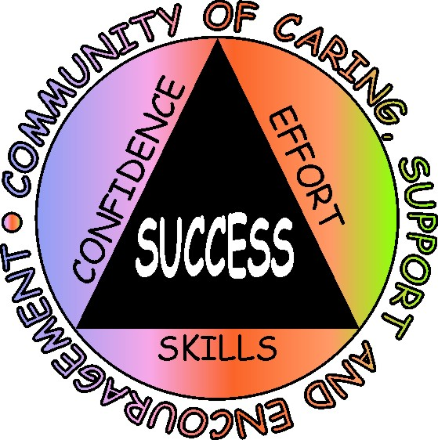
Villares et al
2012
5 Studies of school counselor interventions using SSS
Thirty-nine schools in two large school districts representing students in rural, suburban, and urban settings.
Combined total = 1,279 in grades 4, 5, 6, 8, and 9.
Ethnic composition of the total sample included:
  White = 718 (56%)
  African American = 279 (22%)
  Hispanic = 282 (22%)

Slide 13
Villares et al
2012
5 Studies of school counselor interventions using SSS
The Student Success Skills Program was designed for School Counselor delivery in the classroom and focuses on three essential skill sets:
Cognitive Skills
Social Skills
Self-management Skills

Slide 14




Villares et al (2012) Results of Meta-Analysis
Effect Sizes for SSS on
Standardized Test Scores
ES for Math = .41
(Large)
ES for Reading = .17
(Medium)
Overall ES =
.29
(Large)

Slide 15
What can we expect from interventions aimed at improving math and reading achievement measures by standardzied test scores
Hill, Bloom, Black, & Lipsey (2007)
  Reviewed dozens of meta-analyses of studies to evaluate a wide range of educational interventions and programs.
  They estimated overall effect sizes of
    0.23 for elementary,
    0.27 for middle and
    0.24 for high school students.

Slide 16
Practical significance of an
SSS impact of .41 ES in math
Grades 4-5 An additional 4/5 of a year’s growth
Grades 6-7 An additional 1 year’s growth
Grades 9-10 An additional 1 & 2/3 year’s growth
Hill, C., Bloom, H., Black, A., & Lipsey, M. (2007)

Slide 17
Practical significance of an
SSS impact of
.17 ES in Reading
Grades 4-5 An additional 1/3 of a year’s growth
Grades 6-7 An additional 1/2 year’s growth
Grades 9-10 An additional 1 year’s growth
Hill, C., Bloom, H., Black, A., & Lipsey, M. (2007)

Slide 18
Steps counselors can take to win administrative and teacher support
1. Meet with administration team and present your rationale for gaining more access to students
in order to deliver evidence-based programs shown to improve
  achievement, behavior and climate
  through teaching cognitive, social skills and self-management skills
Align your goal with their goals for school improvement plan

Slide 19
Steps counselors can take to win administrative and teacher support
2. Request to be on school improvement team.
This team usually meets beginning in late winter/early spring to plan for key goals and strategies tied to school improvement plan for next year
It is critically important that your evidence-based classroom and group programs are part of this plan

Slide 20
Steps counselors can take to win administrative and teacher support
3. At beginning of school year in fall, during planning, request that your principal include your classroom and group counseling programs in the overall school improvement plan presented to faculty

Slide 21
Steps counselors can take to win administrative and teacher support
4. Ask for time during pre-planning to go over your program plans and set times to meet with teacher teams
  to plan best times for you to access their students
  for your tier 1 prevention curriculum and for your tier 2 group counseling programs.
  Then publish the schedule

Slide 22
Steps counselors can take to win administrative and teacher support
5. Meet monthly or quarterly with your leadership team to update them on your progress and to address any issues.

Slide 23
Steps counselors can take to win administrative and teacher support
6. Gather data as you implement your classroom and small group programs to show impact.
Examples include:
teacher and student surveys
Student achievement, behavior, attendance and well-being data
Teacher well-being data

Slide 24
Collect and present the most important data
What data would be most important to your administration?
To your teachers?

Slide 25
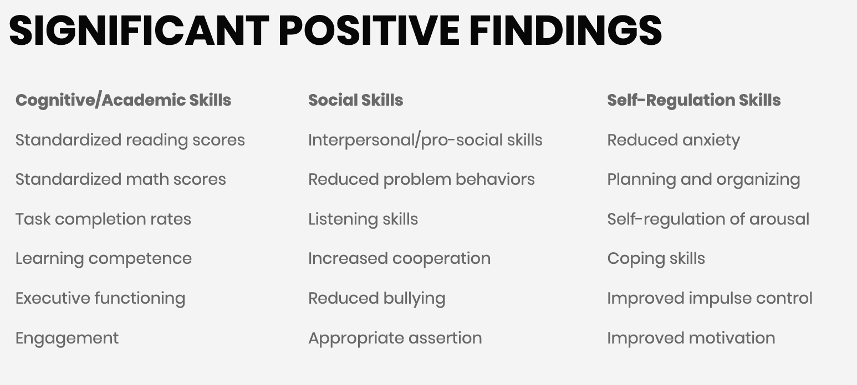
Student Success Skills Published Research Findings
Notes:
Greg
Our 31 studies have measured various SEL outcomes including academic, social and self-management.
Take a look at each category and see if you can find at least 1-2 that would be important to you and your leadership team.

Slide 26

So, What’s In It For Me (WIIFM)?
Improved cognitive, social and self-management skills result in:
  Improved academic achievement
  Improved relationships with peers, classmates
  Improved relationships with teachers, school personnel
  More effective communication skills
  Improved problem-solving skills, conflict resolution skills
  Feeling happier, healthier, less stressed, anxious
  Positive perceptions of classroom and school climate (safer, caring, supportive, encouraging)
  Increased sense of motivation, engagement
Notes:
“So what if I told you that these same researchers who investigated the importance of SEL skills cracked the code and discovered which skills should be taught to students in order to help them have better friendships, get along well with their classmates and teachers, communicate better with their parents, feel happier, healthier, safer, and more supported? Take a minute and read over this list and then pick the top two that are more important to you and share them with a partner.” Next, the counselor should read down the list asking students to raise their hand if that outcome was one they picked.
Go to next slide.

Slide 27

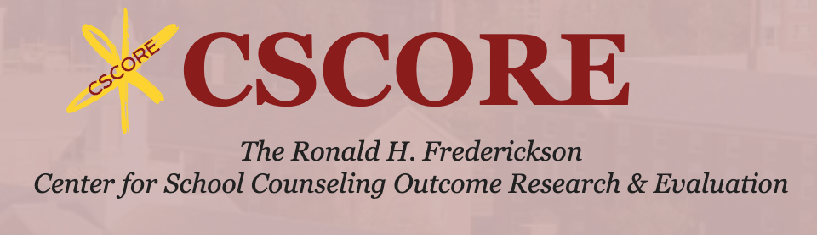


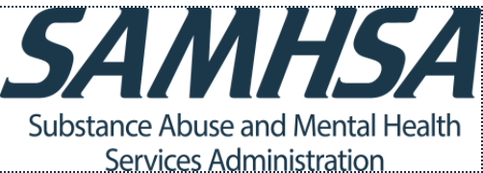

One or more of the the Student Success Skills Programs are featured in all six of these evidence-based guides
Collaborative for Academic, Social,
and Emotional Learning (CASEL) Program Guides
What Works Clearinghouse
Fredrickson Center for School Counseling Outcome Research and Evaluation (CSCORE)
SAMHSA Evidence-Based Practices Resource Center
RAND Center for Social and Emotional Learning Research
The Best Evidence Encyclopedia
Center for Data-Driven Reform in Education
Johns Hopkins University
Notes:
Ellen
The CASEL Guide provides a systematic framework for evaluating the quality of social and emotional programs and applies this framework to identify and rate well-designed, evidence-based SEL programs with potential for broad dissemination to schools across the United States. The Guide also shares best-practice guidelines for district and school teams on how to select and implement SEL programs. Finally, it offers recommendations for future priorities to advance SEL research and practice.
The What Works Clearinghouse (WWC) has valuable tools for locating studies that meet the ESSA evidence requirements. Every Student Succeeds Act (ESSA) are designed to ensure that states, districts, and schools can identify programs, practices, products, and policies that work across various populations.
The Substance Abuse and Mental Health Service Administration Evidence-Based Practices Resource Center provides communities, clinicians, policy-makers and others with the information and tools to incorporate evidence-based practices into their communities or clinical settings.
The Johns Hopkins University School of Education's Center for Data-Driven Reform in Education (CDDRE) was established in 2004 as a research center on low-achieving schools. As its name implies, CDDRE carries out research, development, and dissemination of state, district, school, and classroom strategies that use data on student performance to direct reform efforts.
CSCORE is committed to providing a powerful vision for school counseling in 21st-century schools. This includes providing evidence-based resources that support k-12 students in their academic, social/emotional, college and career aspirations and achievements.
The RAND Center for Social and Emotional Learning (SEL) Research provides new evidence about the effectiveness of SEL programs and practices. We also translate that evidence into concrete guidance to inform policy and practice at all levels of the education system.

Slide 28
Three Metrics to Consider
When Choosing an Evidence-based Program
1. Time it takes to implement (number of classroom lessons)
The impact on academics and behavior the program has shown
The cost to implement the program

Slide 29
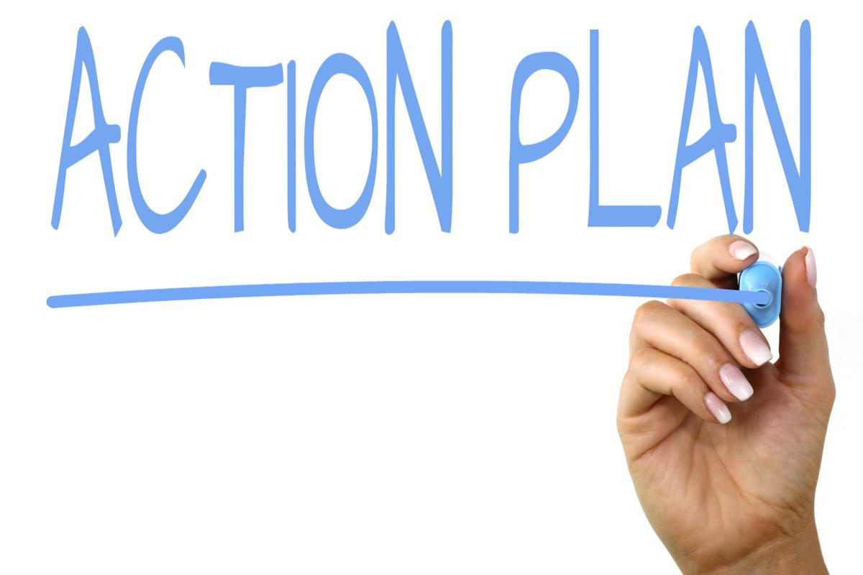
Creating an Action Plan
What I am already doing that is effective and I want to be sure to do more of...
Additional things I can do to support students’ academic, social and self-management development...
As an school counselor, my top goals for this year are to....
Challenges to achieving this goal are...
My action steps to overcome my challenges and achieving this goal are...

Slide 30
Contact Us!
Greg Brigman, Ph.D. – Professor Emeritus
Dept. of Counselor Education - Florida Atlantic University
Program Developers/Researchers/Trainers
Atlantic Education Consultants
gbrigman19@gmail.com
gbrigman@fau.edu
www.studentsuccessskills.com
For more information regarding research, program details, curriculum orders, training

Slide 31
Student Success Skills is a K-12 Set of SEL Programs
Specifically Designed for School Counselor Delivery
Manualized, PPT driven and follows the SAFE method
Classroom program
  For middle/high -Five, 45 minute lessons spaced a week apart
  For Elementary, Eight 30 minute lessons spaced a week apart
3 Monthly booster lesson(s)
Facilitated by the school counselor with support/collaboration from classroom teacher
Multimodal (visual, auditory, kinesthetic/tactile)

Slide 32
Student Success Skills Curriculum
Evidence-based – manualized programs for grades PK-12 (Tier 1, Tier 2)
36 research studies to date…and counting!
Significant Positive Findings
Notes:
Many of you may be familiar with the SSS curriculum which is an EB, manualized program for students in grades PK-12. There are 11 programs available, including ones now for college freshman/sophomores as well as a program for parents. SSS is highly researched with 36 peer-reviewed, published studies to date…I always say “and counting” because our research on the effectiveness of this program continues to grow. I’ve also listed here many of the outcome areas that SSS has been linked to in the areas of academics, social skills and self-regulation. The SSS-SEL program is one of the newest iterations of the SSS line and is a middle and early high school program that focuses on teaching social-emotional learning skills to students in an effort to prevent violence, enhance prosocial skills, and foster a positive classroom and school climate. It consists of 5 45-minute lessons spaced a week apart as well as a monthly booster lesson. Just like all of the other SSS programs, SSS-SEL was designed to be delivered by the school counselor in collaboration with the classroom teacher. Another aspect of the program is that it is multimodal, employing various forms of learning which help keep students active and engaged.

Slide 33
Student Success Skills (SSS) Curriculums
Ready to Learn (PK-1)
Ready for Success (2-3)
SSS Classroom (4-12)
SSS Spanish Translation Classroom (4-12)
SSS Small Group (4-12)
SSS Grade Four
SSS Grade Five
Parent Success Skills
SSS for SEL Success
SSS 2.0 Classroom (6-12)
SSS Spanish Translation Classroom (4-12)
SSS Small Group (4-12)
SSS Classroom (4-12)
Parent Success Skills
SSS 2.0 Classroom (6-12)
SSS Small Group (4-12)
SSS Classroom (4-12)
SSS Spanish Translation Classroom (4-12)
College & Career Success Skills (9-12)
Parent Success Skills
Elementary
Middle
High School
All program descriptions and pricing is available at the SSS website: https://studentsuccessskills.com/
Notes:
Greg
We have recently expanded the SSS K-12 classroom programs in response to school counselors telling us they wanted to continue to use the SSS model for several grade levels w/o repeating the same material. I will highight the new programs in the next few slides. Each program is described on our website.

